Slide 1
“Estimating countries’ peace index through the lens of the world news as monitored by GDELT”
Authors:
Vasiliki Voukelatou
Luca Pappalardo
Ioanna Miliou
Lorenzo Gabrielli
Fosca Giannotti
Presented By:
Er. Baburam Shrestha

Slide 2
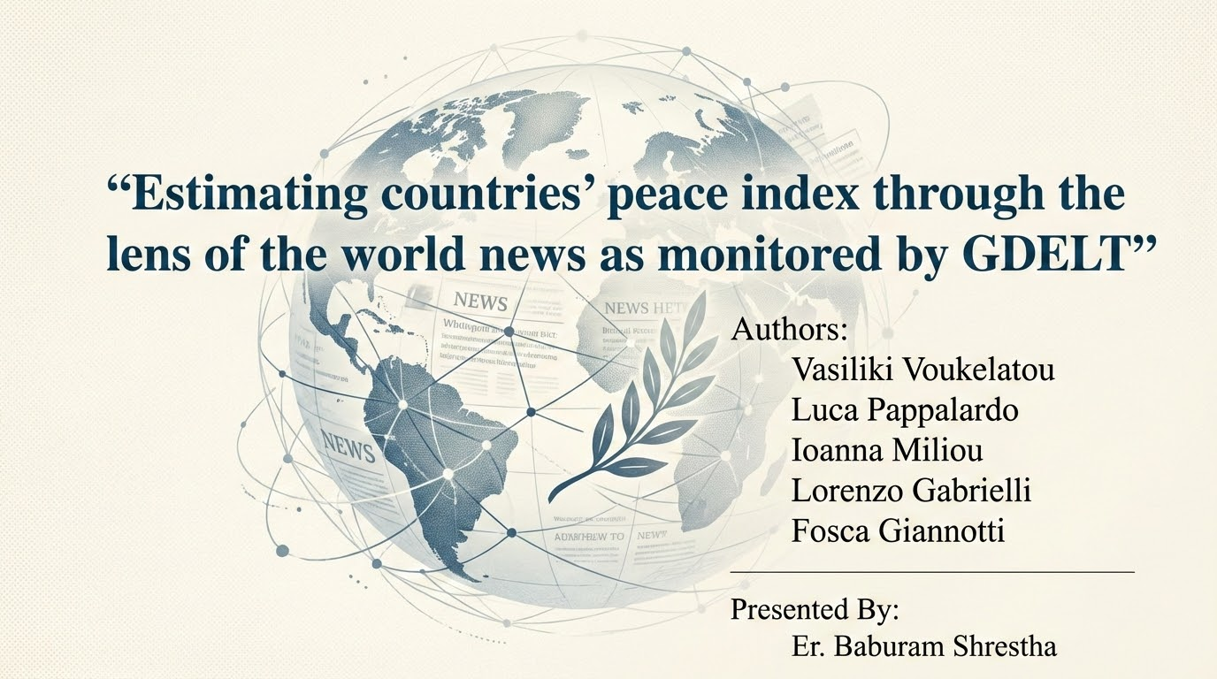

Slide 3
Contents
Peacefulness
Research Goal
Background
Introduction to GDELT
Digital Data in Social Science
Related work
Methodology
Results
Discussion
Conclusion
Reference

Slide 4
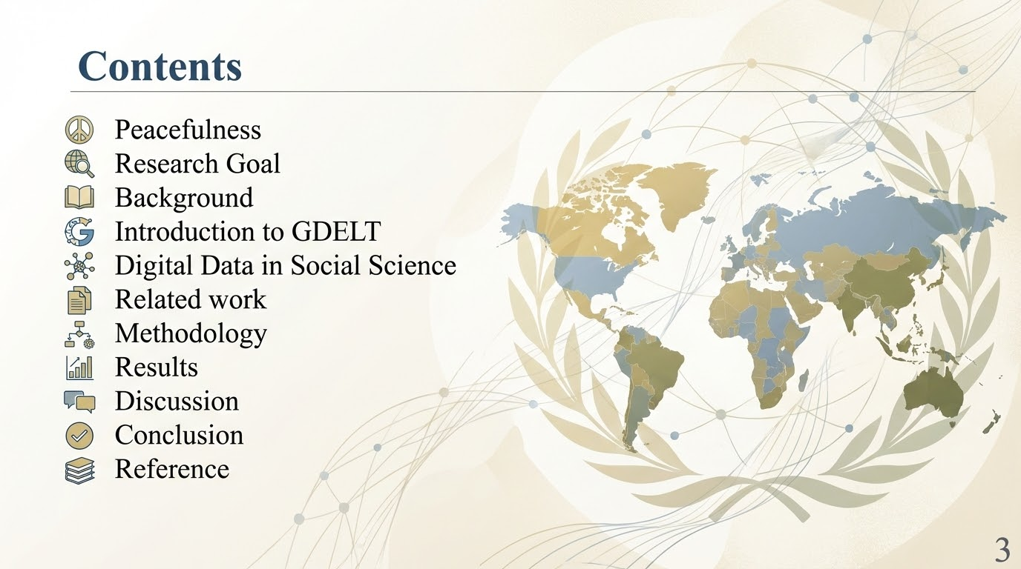

Slide 5
Peacefulness: A Multidimensional Concept
An essential component of well-being and societal progress
Various dimensions:
  Health: Access to healthcare and overall public health
  Socio-economic factors: Economic stability, income equality, and employment
  Safety: Low levels of violence, crime, and social unrest
  Environmental aspects: Sustainability and ecological balance
  Political stability: Harmonious governance and absence of conflict

Slide 6
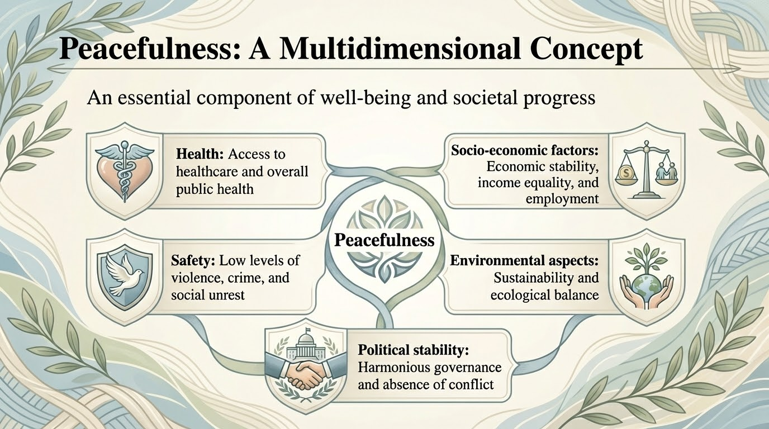

Slide 7
Peacefulness
Dimensions align with Sustainable Development Goals (SDGs), such as “Peace, Justice, and Strong Institutions” defined by UNDP(United Nations Development Programme)
But the Peace Index is calculated traditionally which has some challenges like,
  Delay(Calculated yearly)
  Costly(Survey, governmental Data)

Slide 8
Research Goal
Estimate GPI(Global Peace Index) monthly using GDELT(Global Data on Events, Location and Tone)
Advantages:
  Realtime (Data is captured @15 Minutes)
  Cost-efficient (Data is freely available )
  Frequent updates (Can be possible to calculate and predict the GPI monthly)

Slide 9
Background
GDP(Gross Domestic Product) has been traditionally considered a good indicator of societal well-being
UNDP(United Nations Development Programme) into 17 Sustainable Development Goals such as “No Poverty”, “Zero Hunger”, “Peace, Justice, and Strong Institutions”
SDG defined GPI index such as “health”, “socio-economic”, “safety”, “environment”, “political dimensions” etc.

Slide 10
Introduction to GDELT
GDELT(Global Data on Events, Location, and Tone) is updated every 15 minutes, and it is a free access database
News media attention, sentiment, and social stability, from GDELT digital news database
Can contribute to the estimation of GPI at a higher frequency(monthly) at a low cost, and in a time-efﬁcient way

Slide 11
Digital Data in Social Science
Emergence of new Data Stream:
  Digital platforms like(GDELT) provide real-time insights into socio-political events worldwide
  Overcome the limitation of traditional methods such as high cost, time delay and limited scope

Slide 12
Digital Data in Social Science
Transforming Societal Metrics:
  Digital data enable timely and frequently updates of well-being indicators like GPI
  Capture monthly or even real-time fluctuations in peacefulness

Slide 13
Digital Data in Social Science
Role of Machine Learning:
  Model analyze large-scale digital datasets to identify the patterns and make accurate predictions
  Enhance the reliability and granularity of societal measurements, driving data-driven decision-making

Slide 14
Related Work
Social Media and Mobility Data in Peace Research
GDELT in Conflict and Peace Research

Slide 15
Social Media and Mobility Data in Peace Research
Social Media in Understanding Peace and Conflict:
  Real-time public responses on socio-political events
  Twitter analyze public sentiment, detect social unrest, and predict crime rates
  Conflict Monitoring(Gaza conflict, Iran-Israel Conflict)
  Migration Trends(Twitter estimate migration flows and detect turning points in migration trends)
Mobility Data Applications:
  GPS and mobile network data => socio-economic indicators to prevent crime and monitor civil unrest
  Location-based data to track protests and identify urban crime hotspots)

Slide 16
GDELT in Conflict and Peace Research
Covers 200 event categories, including protests, violence, and diplomatic exchanges
Detect patterns of protests and civil unrest in countries like Egypt, the United States, and India
Analyzes violent events, such as the Sri Lankan Civil War and the Afghan conflict.
Combines GDELT data with refugee statistics and socio-economic indicators for migration forecasts
Provides granular insights into socio-political dynamics, offering a complementary perspective to traditional datasets

Slide 17
Methodology
Data Source
Prediction model
Dynamic Training Approach
Data Preprocessing and Feature Engineering

Slide 18
Methodology: Data Source
Global Peace Index (GPI) Data:
Measures peacefulness across 163 countries.
Available yearly (2008–2019); upsampled linearly to monthly values for analysis
GPI score: Higher values indicate lower peacefulness(1-5)
GDELT Features:
No. Events: Total number of news reports on event categories
Tone: Emotional sentiment of news (-100 to +100, negative to positive)
Goldstein Scale: Stability impact of events (-10 to +10, negative to positive)

Slide 19
Methodology: Prediction Models
Elastic Net:
  Combines Lasso (L1) and Ridge (L2) regularization
  Handle feature selection and multicollinearity
Decision Tree:
  Splits data into branches based on decision rules
  Useful for capturing non-linear relationships
Random Forest:
  Ensemble of decision trees with random sampling for improved accuracy and reduced overfitting

Slide 20
Methodology: Dynamic Training Approach
Rolling Forecast Strategy:
Initial training on data from January 2008 to June 2013
Predicts GPI for July 2013 and dynamically updates with real GPI and GDELT values
Repeats monthly until January 2019, ensuring the model adapts to the latest data

Slide 21
Methodology: Data Preprocessing and Feature Eng.
Querying GDELT with BigQuery:
Extracts country-specific monthly data: No. events, Tone, and Goldstein.
SELECT ActionGeo_CountryCode, MonthYear, EventBaseCode, COUNT(EventBaseCode) AS No_events,
SUM(AvgTone) AS Tone, SUM(GoldsteinScale) AS Goldstein
FROM 'gdelt-bq.full.events'
WHERE (MonthYear BETWEEN 200801 AND 201901) AND (ActionGeo_CountryCode IS NOT NULL)
GROUP BY ActionGeo_CountryCode, MonthYear, EventBaseCode
ORDER BY ActionGeo_CountryCode, EventBaseCode, MonthYear;
Feature Engineering: Aggregated GDELT data for monthly analysis per country.

Slide 22
Results
Model Evaluation Metrics
Results by Country Groups
Results by Country
Variable Importance Analysis
Outlier Analysis
Key Observation

Slide 23
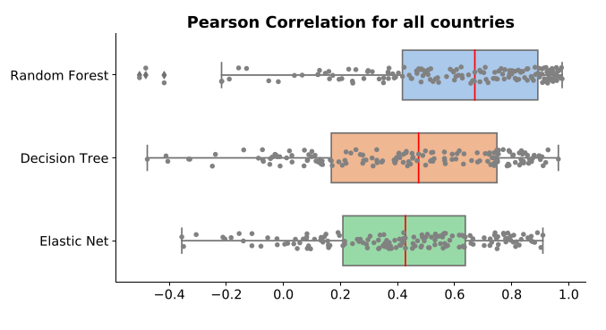
Results: Model Evaluation Metrics

Slide 24
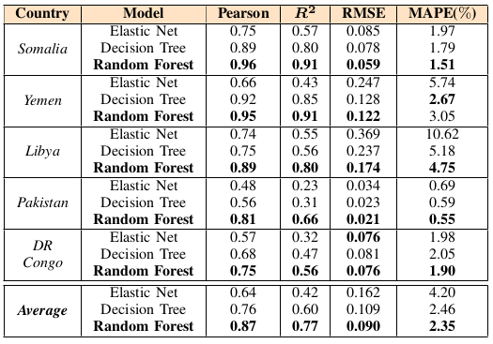
Results: Results by Country Groups
PERFORMANCE INDICATORS WITH RESPECT TO GPI GROUND TRUTH OF
THE PREDICTION MODELS , FOR FIVE WAR - TONE COUNTRIES

Slide 25
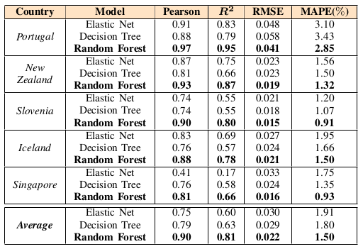
Results: Results by Country Groups
PERFORMANCE INDICATORS WITH RESPECT TO GPI GROUND TRUTH OF
THE PREDICTION MODELS , FOR FIVE PEACEFUL COUNTRIES

Slide 26
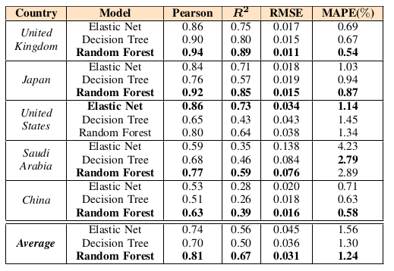
Results: Results by Country Groups
PERFORMANCE INDICATORS WITH RESPECT TO GPI GROUND TRUTH OF
THE PREDICTION MODELS , FOR FIVE POWERFUL COUNTRIES

Slide 27
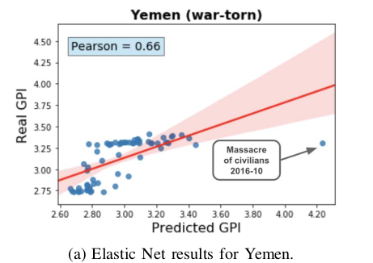
Results: Results by Country

Slide 28
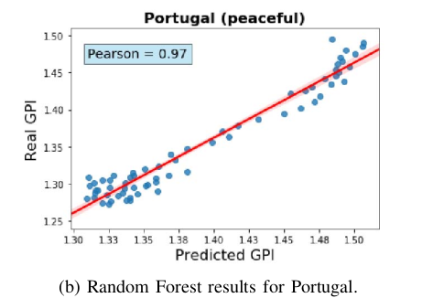
Results: Results by Country

Slide 29
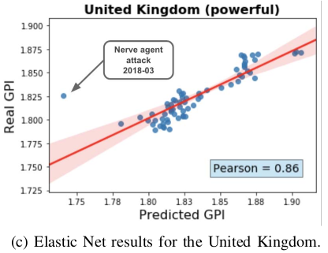
Results: Results by Country

Slide 30
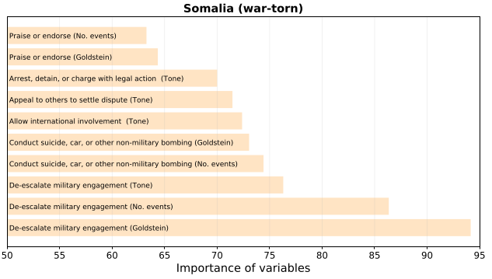
Results: Variable Importance Analysis

Slide 31
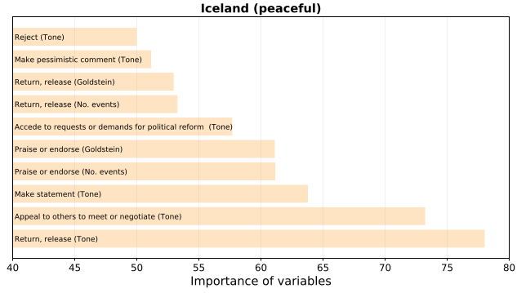
Results: Variable Importance Analysis

Slide 32
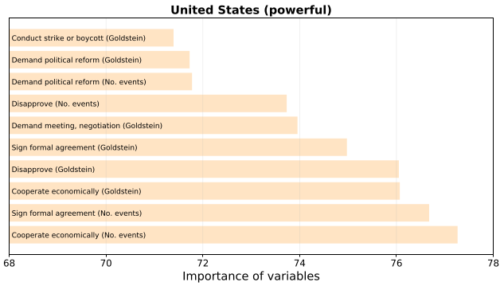
Results: Variable Importance Analysis

Slide 33
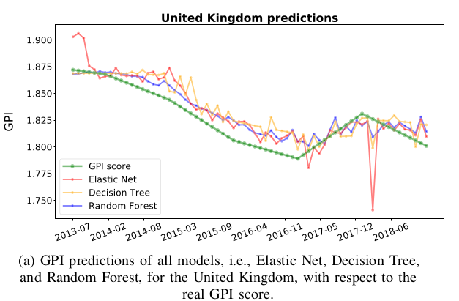
Results: Outlier Analysis

Slide 34
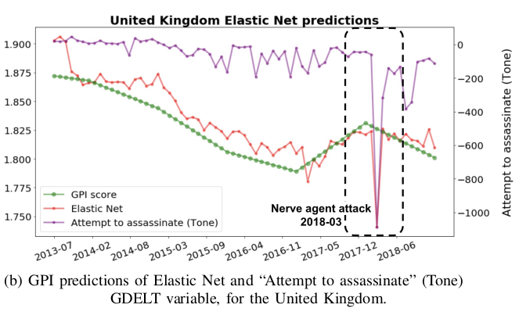
Results: Outlier Analysis

Slide 35
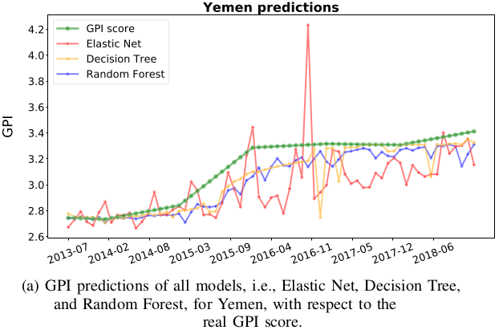
Results: Outlier Analysis

Slide 36
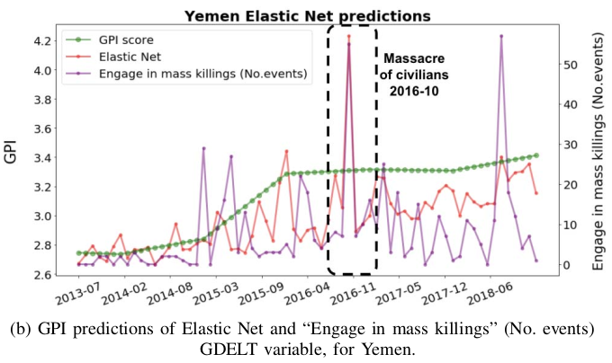
Results: Outlier Analysis

Slide 37
Results: Outlier Analysis

Slide 38
Results: Observation
GDELT provides the worlds’ new and categories(no of Event, Location and Tone)
GDELT captures real-time fluctuations effectively in cost effective and scalable manner

Slide 39
Limitation
Media bias in GDELT database
Linear upsampling assumption

Slide 40
Future Research Directions
Alternative upsampling assumption/methods
Analyzing underrepresented countries
Integrate other conflict-related database like ACLED
Combine GDELT data to other social-media data
Extend the methodology to measure the additional indices like economic stability, political stability, public health, environmental sustainability, and many more.

Slide 41
Conclusion
Random forest superiority
Importance of GDELT database for social good
Real-time monitoring for policy-making/decision making for the societal measurements

Slide 42
References
[1] M. Fleurbaey, “Beyond GDP: The quest for a measure of social welfare,” Journal of Economic literature, vol. 47, no. 4, pp. 1029–75, 2009.
[2] Organisation for Economic Co-operation and Development, How’s life?: measuring well-being. OECD Paris, 2011.
[3] V. Voukelatou, L. Gabrielli, I. Miliou, S. Cresci, R. Sharma, M. Tesconi, and L. Pappalardo, “Measuring objective and subjective well-being: dimensions and data sources,” International Journal of Data Science and Analytics, pp. 1–31, 2020.
[4] UNDP, “Sustainable Development Goals.”
https://sustainabledevelopment.un.org/sdgs, 2015.
[5] J. E. Stiglitz, A. Sen, and J.-P. Fitoussi, Mismeasuring our lives: Why GDP doesn’t add up. The New Press, 2010.
[6] S. Anand and A. Sen, “Human Development Index: Methodology and Measurement.,” 1994.
[7] Rapporto, BES, “Il benessere equo e sostenibile in Italia,” 2015. ISTAT.
[8] The Institute for Economics and Peace, “VISION of HUMANITY.” http: //visionofhumanity.org//, 2017.
[9] C. Melamed, L. Morales, Y. Hsu, J. Poole, B. Rae, I. Rutherford, and A. Jahic, “A World That Counts-Mobilising the Data Revolution for Sustainable Development,” United Nations. Accessed March, vol. 12, p. 2018, 2014.
[10] K. Leetaru, “The GDELT Project.” https://www.gdeltproject.org/, 2013.
[11] M. Brückner and A. Ciccone, “International commodity prices, growth and the outbreak of civil war in Sub-Saharan Africa,” The Economic Journal, vol. 120, no. 544, pp. 519–534, 2010.
[12] P. Gries, A. Fox, Y. Jing, M. Mader, T. J. Scotto, and J. Reiﬂer, “A new measure of the ‘democratic peace’: what country feeling thermometer.

